Slide 1

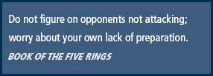
Principles of Information Security,
Fifth Edition
Chapter 1
Introduction to Information Security

Slide 2
Learning Objectives
  Define information security
  Recount the history of computer security and how it evolved into information security
  Define key terms and critical concepts of information security
  List the phases of the security systems development life cycle
  Describe the information security roles of professionals within an organization
Principles of Information Security, Fifth Edition
Notes:
Upon completion of this material, you should be able to:
Define information security
Recount the history of computer security and how it evolved into information security
Define key terms and critical concepts of information security
List the phases of the security systems development life cycle
Describe the information security roles of professionals within an organization

Slide 3
Introduction
Information security: a “well-informed sense of assurance that the information risks and controls are in balance.”—Jim Anderson, Emagined Security, Inc. ‏
Security professionals must review the origins of this field to understand its impact on our understanding of information security today.
Principles of Information Security, Fifth Edition
Notes:
What Is Information Security?
Information security in today’s enterprise is a “well-informed sense of assurance that the information risks and controls are in balance.” – Jim Anderson, Inovant (2002)‏
Before we can begin analyzing the details of information security, it is necessary to review the origins of this field and its impact on our understanding of information security today.

Slide 4
The History of Information Security
Computer security began immediately after the first mainframes were developed.
  Groups developing code-breaking computations during World War II created the first modern computers.
  Multiple levels of security were implemented.
Physical controls limiting access to sensitive military locations to authorized personnel
Rudimentary in defending against physical theft, espionage, and sabotage
Principles of Information Security, Fifth Edition
Notes:
The History Of Information Security
Computer security began immediately after the first mainframes were developed
Groups developing code-breaking computations during World War II created the first modern computers
Multiple levels of security were implemented
Physical controls to limit access to sensitive military locations to authorized personnel
Rudimentary in defending against physical theft, espionage, and sabotage

Slide 5
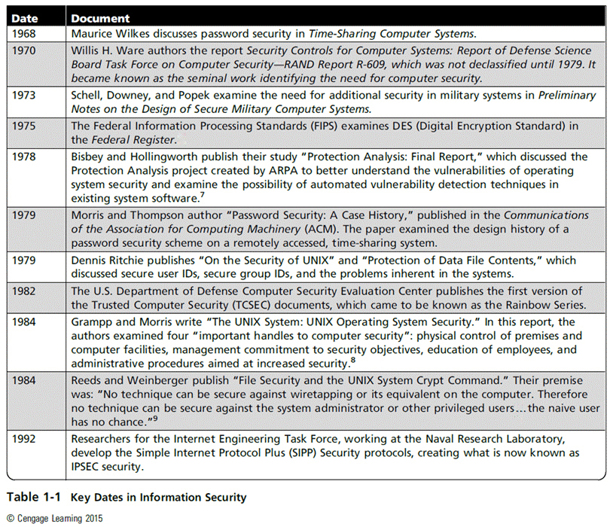
Principles of Information Security, Fifth Edition

Slide 6
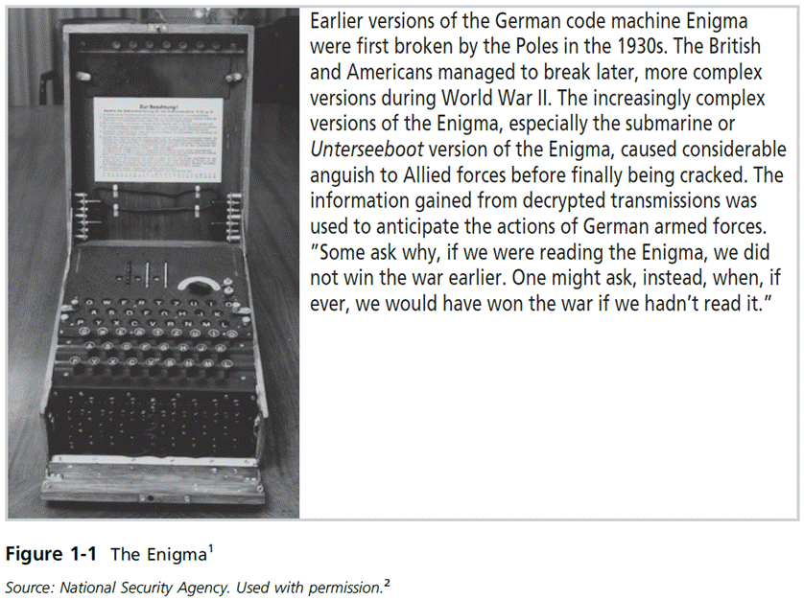
Figure 1-1 – The Enigma
Principles of Information Security, Fifth Edition
Notes:
This picture shows a high-visibility artifact associated with the early days of information security – focusing on the confidentiality of information. This artifact is also part of the study of cryptography from Chapter 8.

Slide 7
The 1960s
Advanced Research Project Agency (ARPA) began to examine the feasibility of redundant networked communications.
Larry Roberts developed the ARPANET from its inception.
Principles of Information Security, Fifth Edition
Notes:
The 1960s
During the 1960s, the Department of Defense’s Advanced Research Procurement Agency (ARPA) began examining the feasibility of a redundant networked communications system designed to support the military’s need to exchange information.
Larry Roberts, known as the founder of the Internet, developed the project from its inception.

Slide 8
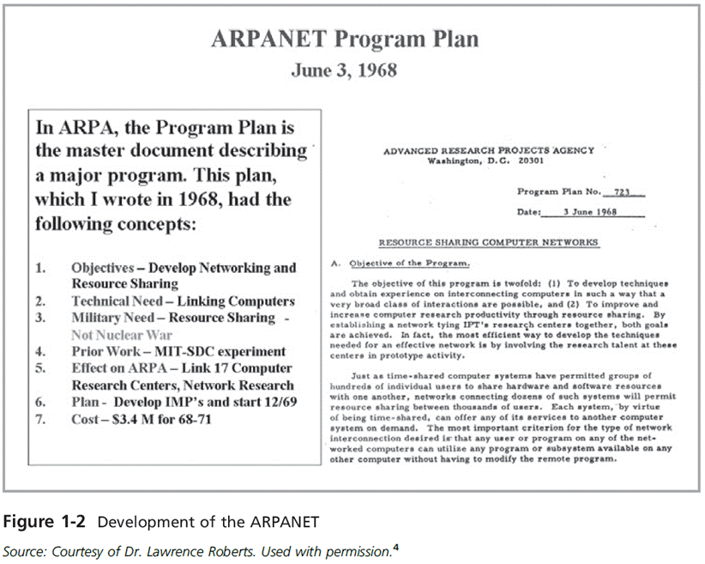
Figure 1-2 - ARPANET
Principles of Information Security, Fifth Edition
Notes:
Founding document from the ARPANET.

Slide 9
The 1970s and 80s
ARPANET grew in popularity, as did its potential for misuse.
Fundamental problems with ARPANET security were identified.
  No safety procedures for dial-up connections to ARPANET
  Nonexistent user identification and authorization to system
Principles of Information Security, Fifth Edition
Notes:
The 1970s and 80s
ARPANET grew in popularity as did its potential for misuse
Fundamental problems with ARPANET security were identified
No safety procedures for dial-up connections to ARPANET
Nonexistent user identification and authorization to system
Late 1970s: microprocessor expanded computing capabilities and security threats

Slide 10
The 1970s and 80s (cont’d)‏
Information security began with Rand Report R-609 (paper that started the study of computer security and identified the role of management and policy issues in it)‏.
The scope of computer security grew from physical security to include:
  Securing the data
  Limiting random and unauthorized access to data
  Involving personnel from multiple levels of the organization in information security
Principles of Information Security, Fifth Edition
Notes:
The 1970s and 80s (cont’d.)
Information security began with Rand Report R-609 (paper that started the study of computer security and identified role of management and policy issues in it)‏
Scope of computer security grew from physical security to include:
Securing the data
Limiting random and unauthorized access to data
Involving personnel from multiple levels of the organization in information security

Slide 11
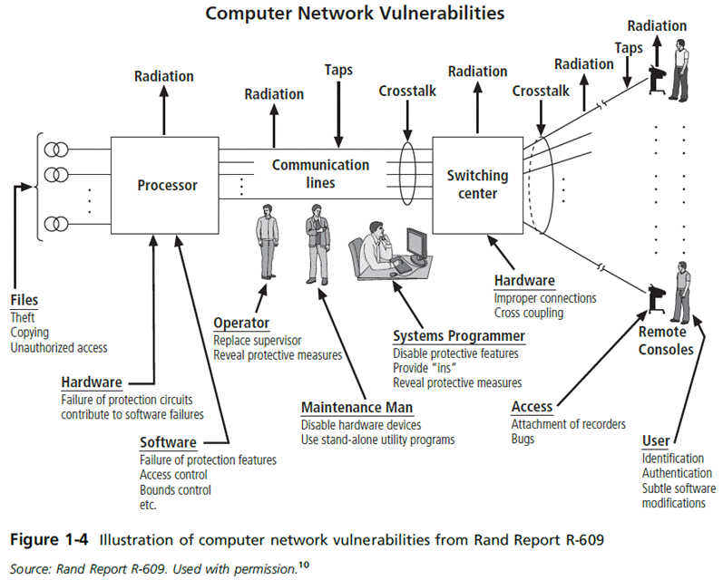
Principles of Information Security, Fifth Edition

Slide 12
MULTICS
Early focus of computer security research centered on a system called Multiplexed Information and Computing Service (MULTICS)‏.
First operating system was created with security integrated into core functions.
Mainframe, time-sharing OS was developed in the mid-1960s by General Electric (GE), Bell Labs, and Massachusetts Institute of Technology (MIT)‏.
Several MULTICS key players created UNIX.
  Primary purpose of UNIX was text processing.
Late 1970s: The microprocessor expanded computing capabilities and security threats.
Principles of Information Security, Fifth Edition
Notes:
MULTICS
Early focus of computer security research centered on a system called Multiplexed Information and Computing Service (MULTICS)‏
First operating system created with security integrated into core functions
Mainframe, time-sharing OS developed in mid-1960s by General Electric (GE), Bell Labs, and Massachusetts Institute of Technology (MIT)‏
Several MULTICS key players created UNIX
Primary purpose of UNIX was text processing
Late 1970s: microprocessor expanded computing capabilities and security threats

Slide 13
The 1990s
Networks of computers became more common, as did the need to connect them to each other.
Internet became the first global network of networks.
Initially, network connections were based on de facto standards.
In early Internet deployments, security was treated as a low priority.
In 1993, DEFCON conference was established for those interested in information security.
Principles of Information Security, Fifth Edition
Notes:
The 1990s
Networks of computers became more common; so did the need to connect them to each other
Internet became first global network of networks
Initially based on de facto standards
In early Internet deployments, security was treated as a low priority
In 1993, DEFCON conference established for those interested in information security

Slide 14
2000 to Present
The Internet brings millions of unsecured computer networks into continuous communication with each other.
The ability to secure a computer’s data was influenced by the security of every computer to which it is connected.
Growing threat of cyber attacks has increased the awareness of need for improved security.
  Nation-states engaging in information warfare
Principles of Information Security, Fifth Edition
Notes:
2000 to Present
The Internet brings millions of unsecured computer networks into continuous communication with each other
Ability to secure a computer’s data influenced by the security of every computer to which it is connected
Growing threat of cyber attacks has increased the awareness of need for improved security
Nation-states engaging in information warfare

Slide 15
What Is Security?
“A state of being secure and free from danger or harm; the actions taken to make someone or something secure.”
A successful organization should have multiple layers of security in place to protect:
  Operations
  Physical infrastructure
  People
  Functions
  Communications
  Information
Principles of Information Security, Fifth Edition
Notes:
What Is Security?
“A state of being secure and free from danger or harm; the actions taken to make someone or something secure”
A successful organization should have multiple layers of security in place to protect:
Operations
Physical Infrastructure
People
Functions
Communications
Information

Slide 16
What Is Security? (cont’d)‏
The protection of information and its critical elements, including systems and hardware that use, store, and transmit that information
Includes information security management, data security, and network security
C.I.A. triangle
  Is a standard based on confidentiality, integrity, and availability, now viewed as inadequate.
  Expanded model consists of a list of critical characteristics of information.
Principles of Information Security, Fifth Edition
Notes:
What Is Security? (cont’d.)
The protection of information and its critical elements, including systems and hardware that use, store, and transmit that information
Includes information security management, data security, and network security
C.I.A. triangle
Is standard based on confidentiality, integrity, and availability, now viewed as inadequate
Expanded model consists of a list of critical characteristics of information

Slide 17
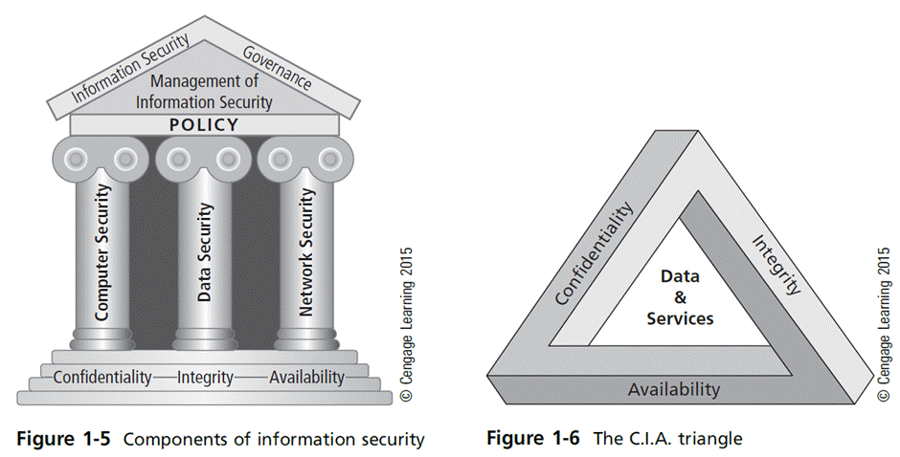
Principles of Information Security, Fifth Edition

Slide 18
Key Information Security Concepts
Access
Asset
Attack
Control, safeguard, or countermeasure
Exploit
Exposure
Loss
Protection profile or security posture
Risk
Subjects and objects
Threat
Threat agent
Vulnerability
Principles of Information Security, Fifth Edition
Notes:
Key Terms
Access - a subject or object’s ability to use, manipulate, modify, or affect another subject or object.
Asset - the organizational resource that is being protected.
Attack - an intentional or unintentional act that can damage or otherwise compromise information and the systems that support it.
Control, Safeguard, or Countermeasure - Security mechanisms, policies, or procedures that can successfully counter attacks, reduce risk, resolve vulnerabilities, and otherwise improve security within an organization.
Exploit – a technique used to compromise a system.
Exposure - a condition or state of being exposed.
Loss: A single instance of an information asset suffering damage or destruction, unintended or unauthorized modification or disclosure, or denial of use.
Protection Profile or Security Posture-entire set of controls and safeguards that the organization implements to protect the asset.
Risk - the probability of an unwanted occurrence.
Subjects and Objects – a computer can be either an agent entity used to conduct an attack, or the target entity.
Threat - a category of objects, people, or other entities that represents a danger to an asset.
Threat Agent – the specific instance or a component of a threat.
Vulnerability - weaknesses or faults in a system or protection mechanism that expose information to attack or damage.

Slide 19
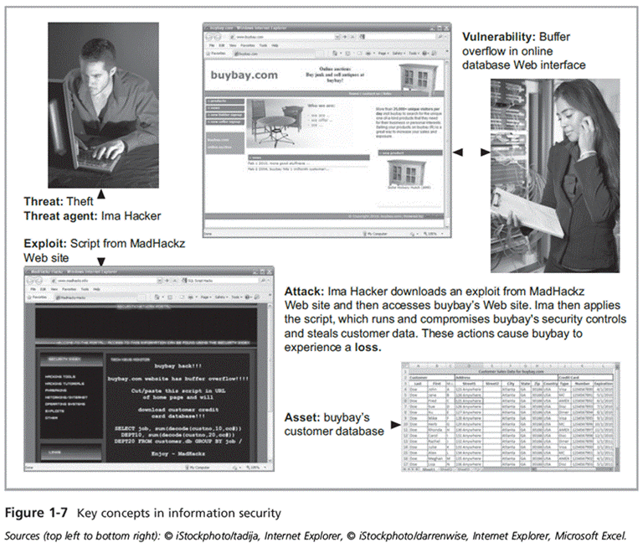
Principles of Information Security, Fifth Edition

Slide 20
Key Information Security Concepts (cont’d)
A computer can be the subject of an attack and/or the object of an attack.
  When the subject of an attack, the computer is used as an active tool to conduct attack.
  When the object of an attack, the computer is the entity being attacked.
Principles of Information Security, Fifth Edition
Notes:
Key Information Security Concepts
When considering the security of information systems components, it is important to understand the concept of the computer as the subject of an attack as opposed to the computer as the object of an attack.
When a computer is the subject of an attack, it is used as an active tool to conduct the attack. When a computer is the object of an attack, it is the entity being attacked.

Slide 21
Critical Characteristics of Information
The value of information comes from the characteristics it possesses:
  Availability
  Accuracy
  Authenticity
  Confidentiality
  Integrity
  Utility
  Possession
Principles of Information Security, Fifth Edition
Notes:
Critical Characteristics of Information
The value of information comes from the characteristics it possesses.
Availability – Enables users who need to access information to do so without interference or obstruction and in the required format. The information is said to be available to an authorized user when and where needed and in the correct format.
Accuracy – Free from mistake or error and having the value that the end user expects. If information contains a value different from the user’s expectations due to the intentional or unintentional modification of its content, it is no longer accurate.
Authenticity –The quality or state of being genuine or original, rather than a reproduction or fabrication. Information is authentic when it is the information that was originally created, placed, stored, or transferred.
Confidentiality – The quality or state of preventing disclosure or exposure to unauthorized individuals or systems.
Integrity – The quality or state of being whole, complete, and uncorrupted. The integrity of information is threatened when the information is exposed to corruption, damage, destruction, or other disruption of its authentic state.
Utility – The quality or state of having value for some purpose or end. Information has value when it serves a particular purpose. This means that if information is available, but not in a format meaningful to the end user, it is not useful.
Possession – The quality or state of having ownership or control of some object or item. Information is said to be in possession if one obtains it, independent of format or other characteristic. While a breach of confidentiality always results in a breach of possession, a breach of possession does not always result in a breach of confidentiality.

Slide 22
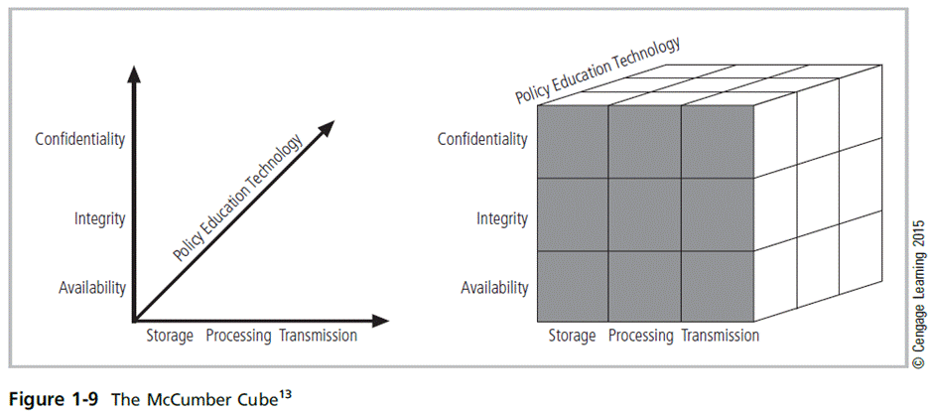
CNSS Security Model
Principles of Information Security, Fifth Edition
Notes:
This graphic informs the fundamental approach of the chapter and can be used to illustrate the intersection of information states (x-axis), key objectives of C.I.A. (y-axis), and the three primary means to implement (policy, education, and technology).

Slide 23
Components of an Information System
Information system (IS) is the entire set of people, procedures, and technology that enable business to use information.
  Software
  Hardware
  Data
  People
  Procedures
  Networks
Principles of Information Security, Fifth Edition
Notes:
Components of an Information System
Information system (IS) is entire set of people, procedures, and technology that enable business to use information.
Software
Hardware
Data
People
Procedures
Networks

Slide 24
Balancing Information Security and Access
Impossible to obtain perfect information security—it is a process, not a goal.
Security should be considered a balance between protection and availability.
To achieve balance, the level of security must allow reasonable access, yet protect against threats.
Principles of Information Security, Fifth Edition
Notes:
Security and Access Balancing
When considering information security, it is important to realize that it is impossible to obtain perfect security. Security is not an absolute; it is a process not a goal.
Security should be considered a balance between protection and availability.
To achieve balance, the level of security must allow reasonable access yet protect against threats.

Slide 25
Approaches to Information Security Implementation: Bottom-Up Approach
Grassroots effort: Systems administrators attempt to improve security of their systems.
Key advantage: technical expertise of individual administrators
Seldom works, as it lacks a number of critical features:
  Participant support
  Organizational staying power
Principles of Information Security, Fifth Edition
Notes:
Bottom-up Approach to Security Implementation
Security can begin as a grass-roots effort when systems administrators attempt to improve the security of their systems. This is referred to as the bottom-up approach.
The key advantage of the bottom-up approach is the technical expertise of the individual administrators.
Unfortunately, this approach seldom works, as it lacks a number of critical features, such as participant support and organizational staying power.

Slide 26
Approaches to Information Security Implementation: Top-Down Approach
Initiated by upper management
  Issue policy, procedures, and processes
  Dictate goals and expected outcomes of project
  Determine accountability for each required action
The most successful type of top-down approach also involves a formal development strategy referred to as systems development life cycle.
Principles of Information Security, Fifth Edition
Notes:
Top-down Approach to Security Implementation
An alternative approach, which has a higher probability of success, is called the top-down approach. The project is initiated by upper management who issue policy, procedures, and processes; dictate the goals and expected outcomes of the project; and determine who is accountable for each of the required actions.
The top-down approach has strong upper-management support, a dedicated champion, dedicated funding, clear planning, and the opportunity to influence organizational culture.
The most successful top-down approach also involves a formal development strategy referred to as a systems development life cycle.

Slide 27
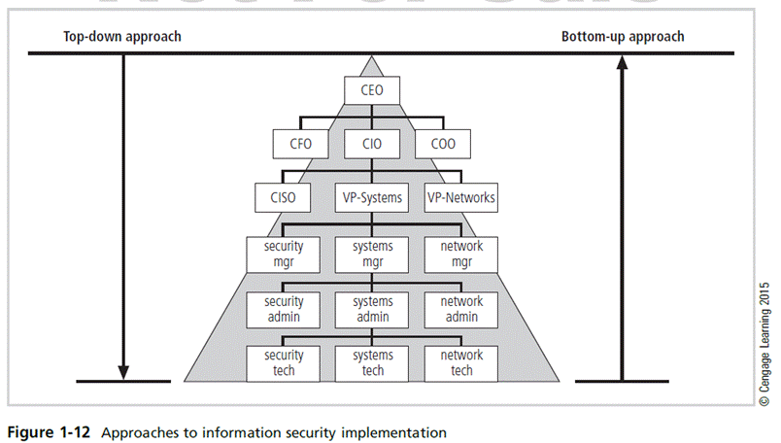
CEO: Chief Executive Officer
CFO: Chief Financial Officer
CIO: Chief Information Officer
COO: Chief Operation Officer
CISO: Chief Information Security Officer
Principles of Information Security, Fifth Edition
Notes:
The key concept here is the direction of the left and right side arrows to show where planning is sourced and from which direction the pressure for success is driven.

Slide 28
The Systems Development Life Cycle
Systems development life cycle (SDLC): a methodology for the design and implementation of an information system
Methodology: a formal approach to solving a problem based on a structured sequence of procedures
Using a methodology:
  Ensures a rigorous process with a clearly defined goal
  Increases probability of success
Traditional SDLC consists of six general phases.
Principles of Information Security, Fifth Edition
Notes:
The Systems Development Life Cycle
Systems Development Life Cycle (SDLC): methodology for design and implementation of an information system
Methodology: formal approach to solving a problem based on a structured sequence of procedures
Using a methodology:
Ensures a rigorous process with a clearly defined goal
Increases probability of success
Traditional SDLC consists of six general phases

Slide 29
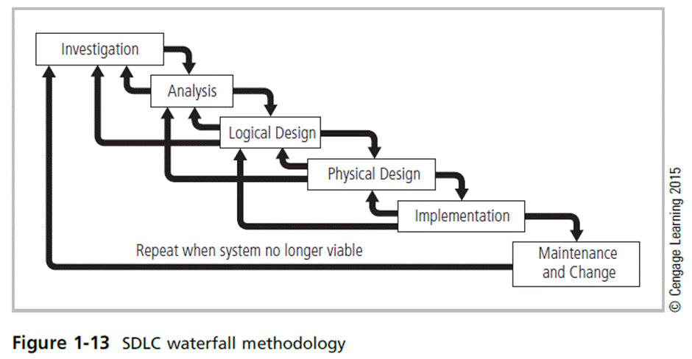
Principles of Information Security, Fifth Edition
Notes:
Very much a traditional SDLC diagram.

Slide 30
Investigation
What problem is the system being developed to solve?
Objectives, constraints, and scope of project are specified.
Preliminary cost-benefit analysis is developed.
At the end of all phases, a process is undertaken to assess economic, technical, and behavioral feasibilities and ensure implementation is worth the time and effort.
Principles of Information Security, Fifth Edition
Notes:
Investigation
What problem is the system being developed to solve?
Objectives, constraints, and scope of project are specified
Preliminary cost-benefit analysis is developed
At the end of all phases, a process is undertaken to assess economic, technical, and behavioral feasibilities and ensure implementation is worth time and effort

Slide 31
Analysis
Consists of assessments of:
  The organization
  Current systems
  Capability to support proposed systems
Analysts determine what new system is expected to do and how it will interact with existing systems.
Analysis ends with documentation of findings and an update of feasibility.
Principles of Information Security, Fifth Edition
Notes:
Analysis
The analysis phase begins with the information learned during the investigation phase.
This phase consists primarily of assessments of the organization, the status of current systems, and the capability to support the proposed systems.
Analysts begin to determine what the new system is expected to do and how it will interact with existing systems.
This phase ends with the documentation of the findings and a feasibility analysis update.

Slide 32
Logical Design
The first and driving factor is the business need.
  Applications are selected to provide needed services.
Data support and structures capable of providing the needed inputs are identified.
Specific technologies are delineated to implement the physical solution.
Analysts generate estimates of costs and benefits to allow comparison of available options.
Feasibility analysis is performed at the end.
Principles of Information Security, Fifth Edition
Notes:
Logical Design
First and driving factor is business need
Applications are selected to provide needed services
Data support and structures capable of providing the needed inputs are identified
Specific technologies are delineated to implement the physical solution
Analysts generate estimates of costs and benefits to allow comparison of available options
Feasibility analysis performed at the end

Slide 33
Physical Design
Specific technologies are selected to support the alternatives identified and evaluated in the logical design.
Selected components are evaluated on make-or-buy decision.
Feasibility analysis is performed.
  Entire solution is presented to organization’s management for approval.
Principles of Information Security, Fifth Edition
Notes:
Physical Design
Specific technologies selected to support the alternatives identified and evaluated in the logical design
Selected components evaluated on make-or-buy decision
Feasibility analysis performed
Entire solution presented to organization’s management for approval

Slide 34
Implementation
Needed software is created.
Components are ordered, received, and tested.
Users are trained and supporting documentation created.
Feasibility analysis is prepared.
  Sponsors are presented with the system for a performance review and acceptance test.
Principles of Information Security, Fifth Edition
Notes:
Implementation
Needed software created
Components ordered, received, and tested
Users trained and supporting documentation created
Feasibility analysis prepared
Sponsors presented with system for performance review and acceptance test

Slide 35
Maintenance and Change
Longest and most expensive phase
Consists of the tasks necessary to support and modify the system for the remainder of its useful life
Life cycle continues until the team determines the process should begin again from the investigation phase.
When current system can no longer support the organization’s mission, a new project is implemented.
Principles of Information Security, Fifth Edition
Notes:
Maintenance and Change
The maintenance and change phase is the longest and most expensive phase of the process.
This phase consists of the tasks necessary to support and modify the system for the remainder of its useful life cycle.
Even though formal development may conclude during this phase, the life cycle of the project continues until it is determined that the process should begin again from the investigation phase. When the current system can no longer support the changed mission of the organization, the project is terminated and a new project is implemented.

Slide 36
The Security Systems Development Life Cycle (SecSDLC)
The same phases used in traditional SDLC can be adapted to support implementation of an IS project.
It involves identifying specific threats and creating specific controls to counter them.
SecSDLC is a coherent program rather than a series of random, seemingly unconnected actions.
Principles of Information Security, Fifth Edition
Notes:
The Security Systems Development Life Cycle
The same phases used in the traditional SDLC can be adapted to support the specialized implementation of a security project.
The fundamental process is the identification of specific threats and the creation of specific controls to counter those threats.
The SecSDLC unifies the process and makes it a coherent program rather than a series of random, seemingly unconnected actions.

Slide 37
Investigation
Identifies process, outcomes, goals, and constraints of the project
Begins with an enterprise information security policy (EISP)‏
  Outlines implementation of a security program within the organization
Organizational feasibility analysis is performed.
Principles of Information Security, Fifth Edition
Notes:
Investigation
The investigation of the SecSDLC begins with a directive from upper management, dictating the process, outcomes, and goals of the project, as well as the constraints placed on the activity.
Frequently, this phase begins with a statement of program security policy that outlines the implementation of security.
Teams of responsible managers, employees, and contractors are organized, problems are analyzed, and scope is defined, including goals, objectives, and constraints not covered in the program policy.
Finally, an organizational feasibility analysis is performed to determine whether the organization has the resources and commitment necessary to conduct a successful security analysis and design.

Slide 38
Analysis
Documents from investigation phase are studied.
Preliminary analysis of existing security policies or programs, along with documented current threats and associated controls
Includes analysis of relevant legal issues that could affect design of the security solution
Risk management begins.
Principles of Information Security, Fifth Edition
Notes:
Analysis
In the analysis phase, the documents from the investigation phase are studied.
The development team conducts a preliminary analysis of existing security policies or programs, along with documented current threats and associated controls.
This phase also includes an analysis of relevant legal issues that could impact the design of the security solution.
The risk management task – identifying, assessing and evaluating the levels of risk facing the organization – also begins in this stage.

Slide 39
Logical Design
Creates and develops blueprints for information security; examines and implements key policies
Incident response actions planned:
  Continuity planning
  Incident response
  Disaster recovery
Feasibility analysis to determine whether project should be continued or outsourced
Principles of Information Security, Fifth Edition
Notes:
Logical Design
The logical design phase creates and develops the blueprints for security, and it examines and implements key policies that influence later decisions.
Also at this stage, critical planning is developed for incident response actions to be taken in the event of partial or catastrophic loss.
Next, a feasibility analysis determines whether or not the project should continue or should be outsourced.

Slide 40
Physical Design
Evaluates information security technology needed to support blueprint, as outlined in logical design
Final physical design chosen.
At end of phase, feasibility study determines readiness of organization for project.
  Champion and sponsors presented with design for approval
Principles of Information Security, Fifth Edition
Notes:
Physical Design
Evaluates information security technology needed to support blueprint, as outlined in logical design
Final physical design chosen
At end of phase, feasibility study determines readiness of organization for project
Champion and sponsors presented with design for approval

Slide 41
Implementation
Security solutions are acquired, tested, implemented, and tested again.
Personnel issues are evaluated; specific training and education programs are conducted.
Entire tested package is presented to upper management for final approval.
Principles of Information Security, Fifth Edition
Notes:
Implementation
The implementation phase is similar to the traditional SDLC.
The security solutions are acquired (made or bought), tested, implemented, and tested again.
Personnel issues are evaluated, and specific training and education programs are conducted.
Finally, the entire tested package is presented to upper management for final approval.

Slide 42
Maintenance and Change
Perhaps the most important phase, given the ever-changing threat environment.
Often, repairing damage and restoring information is a constant effort against an unseen adversary.
Information security profile of an organization requires constant adaptation as new threats emerge and old threats evolve.
Principles of Information Security, Fifth Edition
Notes:
Maintenance and Change
The maintenance and change phase, though last, is perhaps most important, given the high level of ingenuity in today’s threats.
The reparation and restoration of information is a constant duel with an often-unseen adversary.
As new threats emerge and old threats evolve, the information security profile of an organization requires constant adaptation to prevent threats from successfully penetrating sensitive data

Slide 43
Software Assurance—Security in the SDLC
Many organizations recognize the need to include planning for security objectives in the SDLC used to create systems.
  Established procedures to create software that is more capable of being deployed in a secure fashion
This approach is known as software assurance (SA).
Software Assurance Initiative resulted in the publication of Secure Software Assurance (SwA) Common Body of Knowledge (CBK).
Principles of Information Security, Fifth Edition
Notes:
Many organizations recognize need to include planning for security objectives in the SDLC used to create systems
Established procedures to create software more capable of being deployed in a secure fashion
This approach known as software assurance (SA)
Software Assurance Initiative resulted in publication of Secure Software Assurance (SwA) Common Body of Knowledge (CBK)

Slide 44
Software Assurance—Security in the SDLC (cont’d)
SwA CBK, which is a work in progress, contains the following sections:
  Nature of Dangers
  Fundamental Concepts and Principles
  Ethics, Law, and Governance
  Secure Software Requirements
  Secure Software Design
  Secure Software Construction
  Secure Software Verification, Validation, and Evaluation
  Secure Software Tools and Methods
  Secure Software Processes
  Secure Software Project Management
  Acquisition of Secure Software
  Secure Software Sustainment
Principles of Information Security, Fifth Edition
Notes:
SwA CBK is a work in progress, contains following sections:
Nature of Dangers
Fundamental Concepts and Principles
Ethics, Law, and Governance
Secure Software Requirements
Secure Software Design
Secure Software Construction
Secure Software Verification, Validation, and Evaluation
Secure Software Tools and Methods
Secure Software Processes
Secure Software Project Management
Acquisition of Secure Software
Secure Software Sustainment

Slide 45
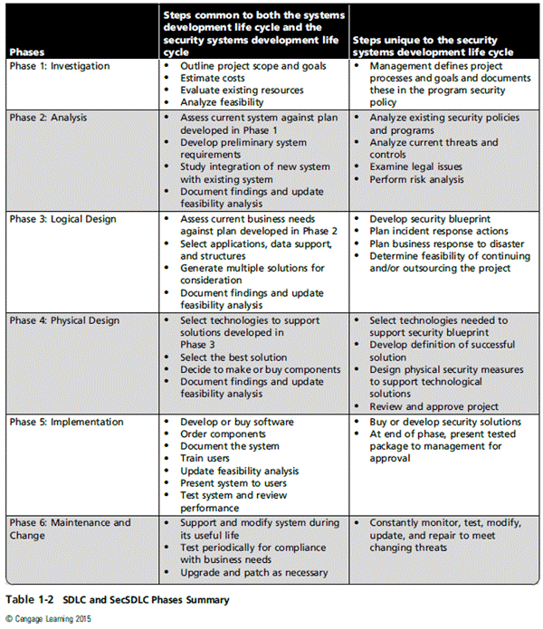
Principles of Information Security, Fifth Edition

Slide 46
Software Design Principles
Software development leaders J. H. Saltzer and M. D. Schroeder first identified security principles:
  Economy of mechanism
    security mechanisms should be as simple as possible.
  Fail-safe defaults
    the default access to an object is none.
  Complete mediation
    all accesses to objects be checked to ensure they are allowed
  Open design
    involves the development of physical products, machines and systems through use of publicly shared design information
Principles of Information Security, Fifth Edition

Slide 47
Software Design Principles
  Separation of privilege
    best practice applied by organizations to broadly separate users and processes based on different levels of trust, needs, and privilege requirements
  Least privilege
    any user, program, or process should have only the bare minimum privileges necessary to perform its function.
  Least common mechanism
    mechanisms used to access resources should not be shared
  Psychological acceptability
    security mechanisms should not make the resource more difficult to access than if the security mechanisms were not present.
Principles of Information Security, Fifth Edition

Slide 48
The NIST Approach to Securing the SDLC
NIST Special Publication 800-64 rev. 2 maintains that early integration of security in the SDLC enables agencies to maximize return on investment through:
  Early identification and mitigation of security vulnerabilities and misconfigurations
  Awareness of potential engineering challenges
  Identification of shared security services and reuse of security strategies and tools
  Facilitation of informed executive decision making
Principles of Information Security, Fifth Edition
Notes:
The NIST Approach to Securing the SDLC
NIST Special Publication 800-64 rev. 2 maintains that early integration of security in the SDLC enables agencies to maximize return on investment through:
Early identification and mitigation of security vulnerabilities and misconfigurations
Awareness of potential engineering challenges
Identification of shared security services and reuse of security strategies and tools
Facilitation of informed executive decision making

Slide 49
The NIST Approach: Initiation
Security at this point is looked at in terms of business risks, with information security office providing input.
Key security activities include:
  Delineation of business requirements in terms of confidentiality, integrity, and availability
  Determination of information categorization and identification of known special handling requirements to transmit, store, or create information
  Determination of any privacy requirements
Principles of Information Security, Fifth Edition
Notes:
Initiation
Security at this point looked at in terms of business risks, with information security office providing input
Key security activities include:
Delineation of business requirements in terms of confidentiality, integrity, and availability
Determination of information categorization and identification of known special handling requirements to transmit, store, or create information
Determination of any privacy requirements

Slide 50
The NIST Approach: Development/Acquisition
Key security activities include:
  Conducting risk assessment and using results to supplement baseline security controls
  Analyzing security requirements
  Performing functional and security testing
  Preparing initial documents for system certification and accreditation
  Designing security architecture
Principles of Information Security, Fifth Edition
Notes:
Development/Acquisition
Key security activities include:
Conduct risk assessment and use results to supplement baseline security controls
Analyze security requirements
Perform functional and security testing
Prepare initial documents for system certification and accreditation
Design security architecture

Slide 51
The NIST Approach: Implementation/Assessment
System is installed and evaluated in operational environment.
Key security activities include:
  Integrating information system into its environment
  Planning and conducting system certification activities in synchronization with testing of security controls
  Completing system accreditation activities
Principles of Information Security, Fifth Edition
Notes:
Implementation/Assessment
System installed and evaluated in operational environment
Key security activities include:
Integrate information system into its environment
Plan and conduct system certification activities in synchronization with testing of security controls
Complete system accreditation activities

Slide 52
The NIST Approach: Operations and Maintenance
Systems are in place and operating, enhancements and/or modifications to the system are developed and tested, and hardware and/or software are added or replaced.
Key security activities include:
  Conducting operational readiness review
  Managing configuration of system
  Instituting process and procedure for assured operations and continuous monitoring of information system’s security controls
  Performing reauthorization as required
Principles of Information Security, Fifth Edition
Notes:
Operations and Maintenance:
Systems are in place and operating, enhancements and/or modifications to the system are developed and tested, and hardware and/or software added or replaced
Key security activities include:
Conduct operational readiness review
Manage configuration of system
Institute process and procedure for assured operations and continuous monitoring of information system’s security controls
Perform reauthorization as required

Slide 53
The NIST Approach: Disposal
Provides for disposal of system and closeout of any contracts in place
Key security activities include:
  Building and executing disposal/transition plan
  Archival of critical information
  Sanitization of media
  Disposal of hardware and software
Principles of Information Security, Fifth Edition
Notes:
Disposal:
Provides for disposal of system and closeout of any contracts in place
Key security activities include:
Building and executing disposal/transition plan
Archival of critical information
Sanitization of media
Disposal of hardware and software

Slide 54
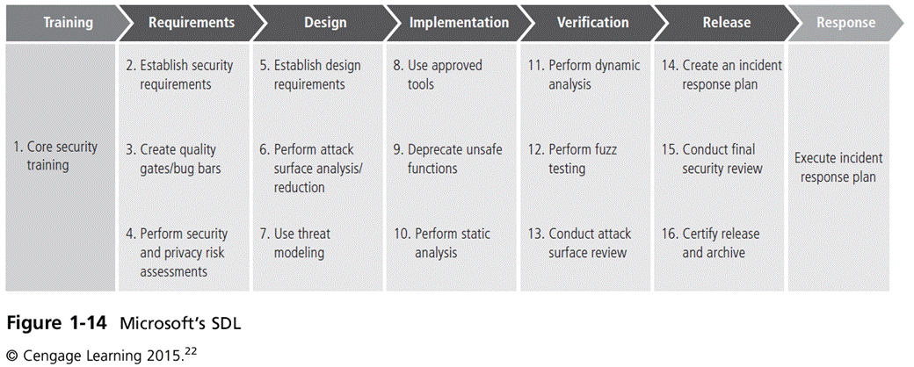
Principles of Information Security, Fifth Edition

Slide 55
Security Professionals and the Organization
Wide range of professionals are required to support a diverse information security program.
Senior management is the key component.
Additional administrative support and technical expertise are required to implement details of IS program.
Principles of Information Security, Fifth Edition
Notes:
Security Professionals and the Organization
It takes a wide range of professionals to support a diverse information security program.
To develop and execute specific security policies and procedures, additional administrative support and technical expertise is required.

Slide 56
Senior Management
Chief information officer (CIO)‏
  Senior technology officer
  Primarily responsible for advising the senior executives on strategic planning
Chief information security officer (CISO)‏
  Has primary responsibility for assessment, management, and implementation of IS in the organization
  Usually reports directly to the CIO
Principles of Information Security, Fifth Edition
Notes:
Senior Management
Chief Information Officer – The senior technology officer, although other titles such as Vice President of Information, VP of Information Technology, and VP of Systems may be used. The CIO is primarily responsible for advising the Chief Executive Officer, President, or company owner on the strategic planning that affects the management of information in the organization.
Chief Information Security Officer – The individual primarily responsible for the assessment, management, and implementation of securing the information in the organization. The CISO may also be referred to as the Manager for Security, the Security Administrator, or a similar title.

Slide 57
Information Security Project Team
A small functional team of people who are experienced in one or multiple facets of required technical and nontechnical areas:
  Champion
  Team leader
  Security policy developers
  Risk assessment specialists
  Security professionals
  Systems administrators
  End users
Principles of Information Security, Fifth Edition
Notes:
Security Project Team
A number of individuals who are experienced in one or multiple requirements of both the technical and nontechnical areas.
The champion: A senior executive who promotes the project and ensures its support, both financially and administratively, at the highest levels of the organization.
The team leader: A project manager, who may be a departmental line manager or staff unit manager, who understands project management, personnel management, and information security technical requirements.
Security policy developers: Individuals who understand the organizational culture, policies, and requirements for developing and implementing successful policies.
Risk assessment specialists: People who understand financial risk assessment techniques, the value of organizational assets, and the security methods to be used.
Security professionals: Dedicated, trained, and well-educated specialists in all aspects of information security from both technical and nontechnical standpoints.
Systems administrators: People with the primary responsibility for administering the systems that house the information used by the organization.
End users: Those whom the new system will most directly impact. Ideally, a selection of users from various departments, levels, and degrees of technical knowledge assist the team in focusing on the application of realistic controls applied in ways that do not disrupt the essential business activities they seek to safeguard.

Slide 58
Data Responsibilities
Data owners: senior management responsible for the security and use of a particular set of information
Data custodian: responsible for information and systems that process, transmit, and store it
Data users: individuals with an information security role
Principles of Information Security, Fifth Edition
Notes:
Data Responsibilities
Data owners: Members of senior management who are responsible for the security and use of a particular set of information. The data owners usually determine the level of data classification (discussed later), as well as the changes to that classification required by organizational change. The data owners work with subordinate managers to oversee the day-to-day administration of the data.
● Data custodians: Working directly with data owners, data custodians are responsible for the information and the systems that process, transmit, and store it. Depending on the size of the organization, this may be a dedicated position, such as the CISO, or it may be an additional responsibility of a systems administrator or other technology manager. The duties of a data custodian often include overseeing data storage and backups, implementing the specific procedures and policies laid out in the security policies and plans, and reporting to the data owner.
● Data users: Everyone in the organization is responsible for the security of data, so data users are included here as individuals with an information security role.

Slide 59
Communities of Interest
Group of individuals united by similar interests/values within an organization
  Information security management and professionals
  Information technology management and professionals
  Organizational management and professionals
Principles of Information Security, Fifth Edition
Notes:
Communities of Interest
Each organization develops and maintains its own unique culture and values. Within that corporate culture, there are communities of interest. These include:
Information Security Management and Professionals
Information Technology Management and Professionals
Organizational Management and Professionals

Slide 60
Information Security: Is It an Art or a Science?
Implementation of information security is often described as a combination of art and science.
“Security artisan” idea: based on the way individuals perceive system technologists and their abilities
Principles of Information Security, Fifth Edition
Notes:
Information Security: Is It an Art or a Science?
With the level of complexity in today’s information systems, the implementation of information security has often been described as a combination of art and science.
The concept of the security artisan is based on the way individuals perceived systems technologists since computers became commonplace.

Slide 61
Security as Art
No hard and fast rules nor many universally accepted complete solutions
No manual for implementing security through entire system
Principles of Information Security, Fifth Edition
Notes:
Security as Art
There are no hard and fast rules regulating the installation of various security mechanisms.
Nor are there many universally accepted complete solutions.
While there are many manuals to support individual systems, once these systems are interconnected, there is no magic user’s manual for the security of the entire system.
This is especially true with the complex levels of interaction between users, policy, and technology controls.

Slide 62
Security as Science
Dealing with technology designed for rigorous performance levels
Specific conditions cause virtually all actions in computer systems.
Almost every fault, security hole, and systems malfunction is a result of interaction of specific hardware and software.
If developers had sufficient time, they could resolve and eliminate faults.
Principles of Information Security, Fifth Edition
Notes:
Security as Science
We are dealing with technology developed by computer scientists and engineers—technology designed to perform at rigorous levels of performance.
Even with the complexity of the technology, most scientists would agree that specific scientific conditions cause virtually all actions that occur in computer systems.
Almost every fault, security hole, and systems malfunction is a result of the interaction of specific hardware and software.
If the developers had sufficient time, they could resolve and eliminate these faults.

Slide 63
Security as a Social Science
Social science examines the behavior of individuals interacting with systems.
Security begins and ends with the people that interact with the system, intentionally or otherwise.
Security administrators can greatly reduce the levels of risk caused by end users and create more acceptable and supportable security profiles.
Principles of Information Security, Fifth Edition
Notes:
Security as a Social Science
There is a third view: security as a social science.
Social science examines the behavior of individuals as they interact with systems, whether societal systems or in our case information systems.
Security begins and ends with the people inside the organization and the people that interact with the system planned or otherwise.
End users that need the very information the security personnel are trying to protect may be the weakest link in the security chain.
By understanding some of the behavioral aspects of organizational science and change management, security administrators can greatly reduce the levels of risk caused by end users and create more acceptable and supportable security profiles.

Slide 64
Summary
Information security is a “well-informed sense of assurance that the information risks and controls are in balance.”
Computer security began immediately after the first mainframes were developed.
Successful organizations have multiple layers of security in place: physical, personal, operations, communications, network, and information.
Principles of Information Security, Fifth Edition

Slide 65
Summary (cont’d)‏
Security should be considered a balance between protection and availability.
Information security must be managed similar to any major system implemented in an organization using a methodology like SecSDLC.
Implementation of information security is often described as a combination of art and science.
Principles of Information Security, Fifth Edition

